Slide 1
Online Immediate Commitment Job Scheduling A Machine Learning Approach
Philip Varghese Modayil
Matr No: 229225

Slide 2

Cloud Computing: An Introduction
What is cloud computing?
computing services including servers, over the Internet.
Servers, storage, databases, networking.
SaaS, PaaS, IaaS.
What is IaaS?
Compute, storage, networking.
On a pay as you go basis.
Usually but not exclusively computing power

Slide 3
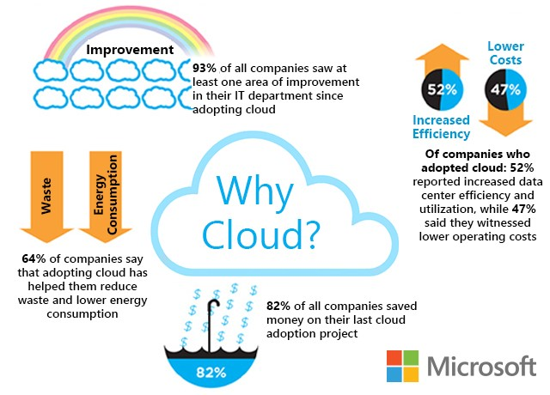

Slide 4
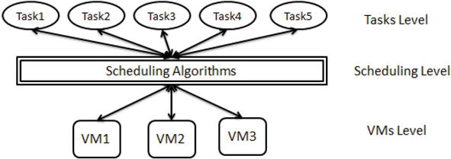
Problem: Limited number of resources to incoming activities and applications
Solution: A scheduler
DOI: 10.5772/intechopen.86873

Slide 5
Terminologies
Immediate Commitment:
Commitment on arrival.
Agreement is binding.
Penalty on breach.
Legality and Slack :
Arrival
at t = 0
Deadline at
t = 15
Pj = 10
Completion at t = 10
Scheduled at t = 0
Slack

Slide 6


Tight slack if:
$p_{j}$: processing time of the job.
$r_{j}$ : release date of the job.
$d_{j}$: deadline of the job.
m : number of machines
$$d_{j}≥ \left(1+ ∈\right)p_{j}+r_{j}$$

Slide 7
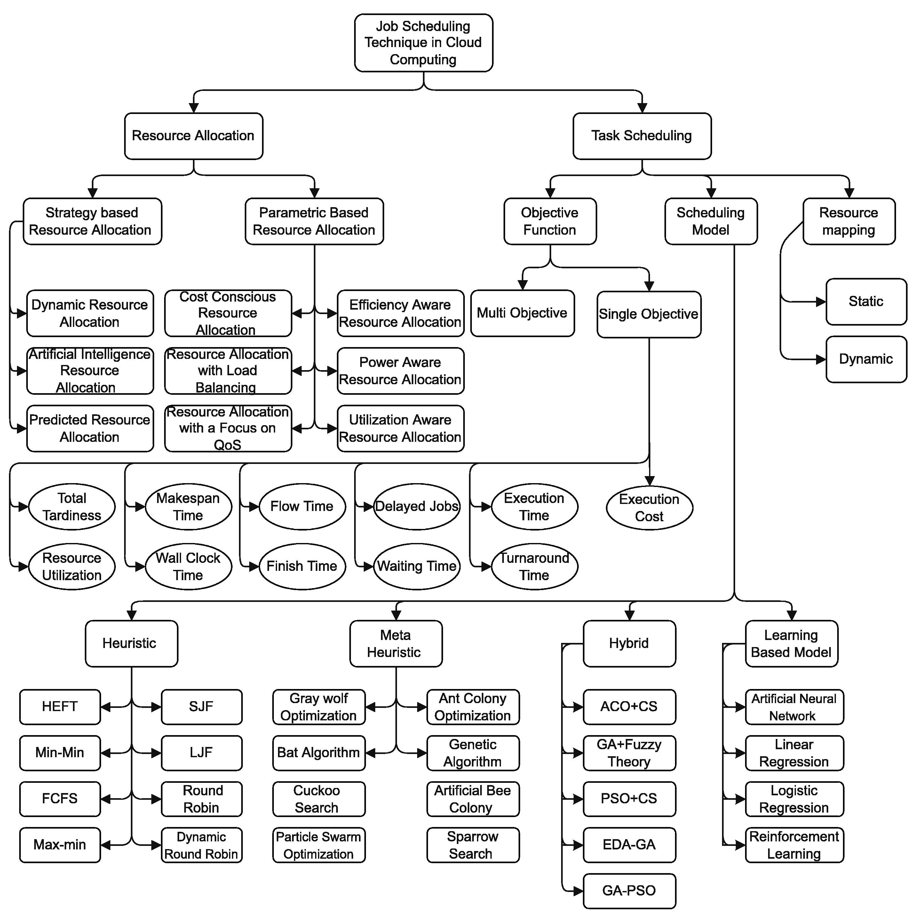
Problem Scenario

Slide 8
This project aims at:
Maximize machine utilization.
Implement job scheduling with machine learning approach.
Schedule jobs with immediate commitment.
What are our limitations?
Extremely random process.
not feasible to identify any pattern.
What do we consider?
Conventional ML approaches not feasible.
Reinforcement Learning.

Slide 9
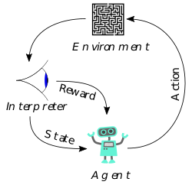
Why Reinforcement Learning?
It is adversary v/s scheduler.
Strategize from multiple scenarios.
Generate map from current states to actions.
Our RL approach
Learn from random actions.
No hard rejection rule.
Dense rewards.

Slide 10
Prior Knowledge
This paper teaches us that the jobs need to be judged based on a rejection criterion even if it is legal to accept it. S. Jamalabadi, C. Schwiegelshohn, and U. Schwiegelshohn, “Commitment and slack for online load maximization,” in Proceedings of the 32nd ACM Symposium on Parallelism in Algorithms and Architectures, 2020, pp. 339–348.
The majority of methods in Reinforcement Learning rely on well-known benchmarks from the OpenAI gym library.

Slide 11
Determining Quality Of Incoming Job
Aim: maximize machine utilization.
Anticipate higher pj jobs
Leave room for higher pj jobs.
Non-profitable jobs rejected.
Profitability:
a simple logical method.
Determine quality of action taken.

Slide 12
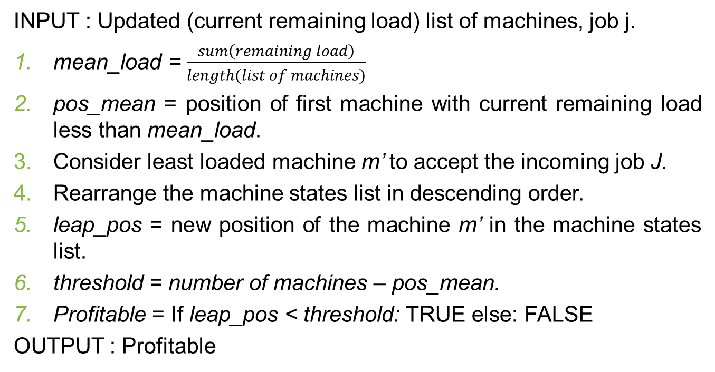
Steps To Determine Profitability
INPUT : Updated (current remaining load) list of machines, job j.
mean_load = $\frac{sum\left(remaining load\right)}{length(list of machines)}$
pos_mean = position of first machine with current remaining load less than mean_load.
Consider least loaded machine m’ to accept the incoming job J.
Rearrange the machine states list in descending order.
leap_pos = new position of the machine m’ in the machine states list.
threshold = number of machines – pos_mean.
Profitable = If leap_pos < threshold: TRUE else: FALSE
OUTPUT : Profitable

Slide 13
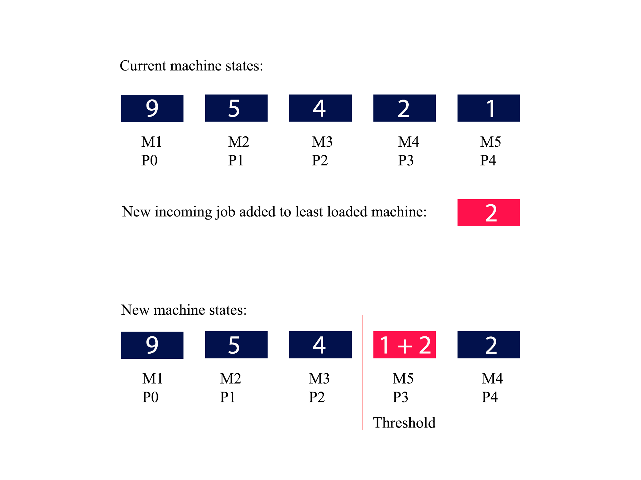

Slide 14
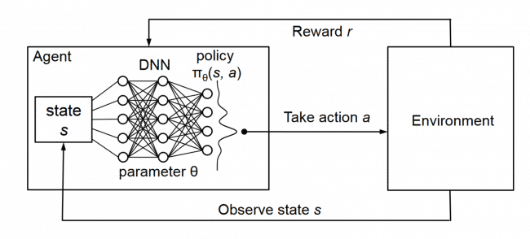
Reinforcement Learning Algorithm
The reinforcement learning algorithm used here is the DQN algorithm.
The usage of DQN is mostly for
Deterministic environments where, if we had a function Q:StateXAction->R that tells us what the reward we shall get then it is possible to create a policy that maximizes our rewards.

Slide 15
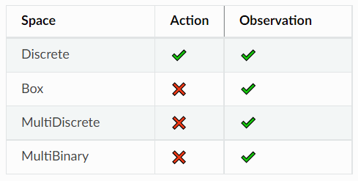
This is parallel with our problem and hence we have chosen to use DQN algorithm even though our environment is highly random.

Slide 16
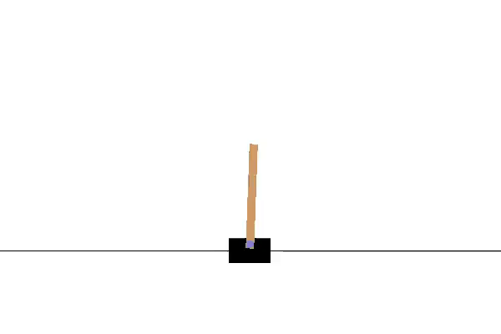
OpenAI GYM
Open source interface to reinforcement learning tasks. The gym library provides an easy-to-use suite of reinforcement learning tasks.
CartPole-v1 environment : maximize number of stable instances.

Slide 17
Personalizing CartPole-v1 Environment
We can draw parallels between CartPole-v1 and our scenario.
We need to maximize the number of profitable actions taken in one whole run of the job file.
Step function:
Read job
Update machine states
Determine profitability
Update observation space
Take random action
Give reward

Slide 18
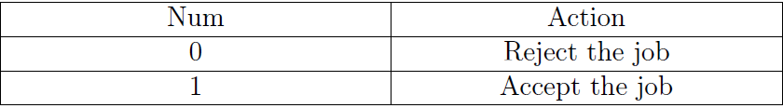
LEARNING ENVIRONMENT AND SET UP
Action Space:

Slide 19
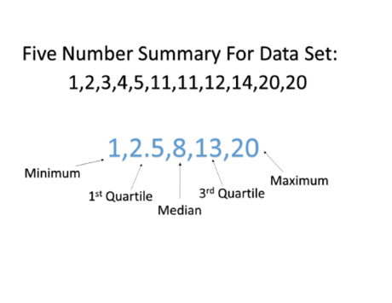
Observation Space: The current load on the machines and the incoming job properties need to be considered.
Problem: As the number of machines vary the observation space varies. No boundedness.
Solution: Five number summary / box plot representation.

Slide 20
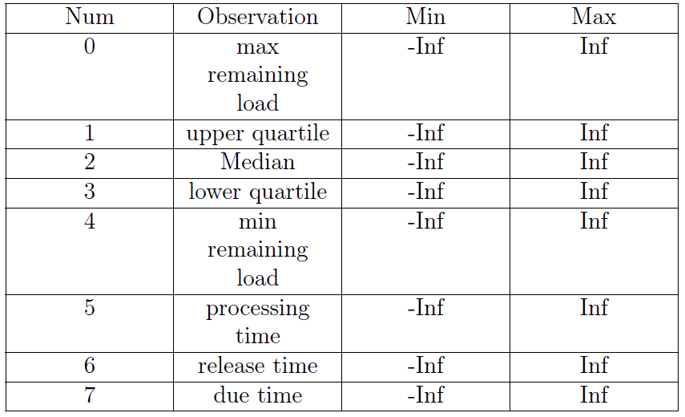

Slide 21
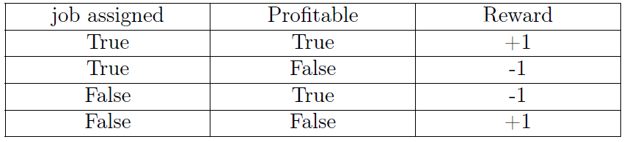
Reward Scheme: Maximize profitable actions.

Slide 22
Training
Used stable baselines 3 libraries for Reinforcement Learning implementation.
Trained on 10 days’ of data.
Each day’s data contains 990 text files with over 10378 job details in each of them. Hence a total of 9900 different scenarios were considered while training.
The environment was trained for 130 million timesteps (120 hours) and a model generated at each 1 millionth timestep.

Slide 23
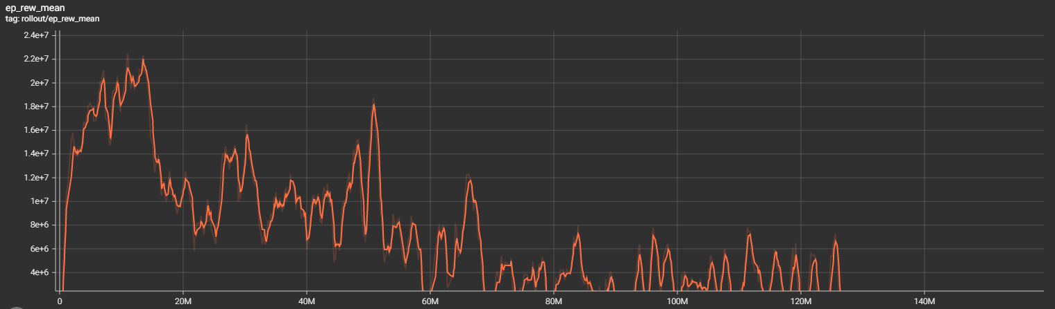
The peak reward was obtained at the 13.53 millionth timestep and hence we shall regard the model generated at 14 millionth timestep to be the optimal model obtained from the training.
Training reward mean

Slide 24
Testing And Results
For files Days 11 – 14, number of machines (10,20,30,..,200).
Parameters included in the test results are:
Accepted Load (L_a) | Sum of pj accepted to system
Rejected Load (L_r) | Sum of pj rejected to system
Total load (L_t) | L_a + L_r
Makespan (C_max) | m x latest completion time
Available Resources (Ar) | min(C_max, L_t)
Optimal load processed (L_t_opt) | max(Ar greedy best fit, Ar Ml alg)
Performance Ratio | L_t_opt / L_a

Slide 25
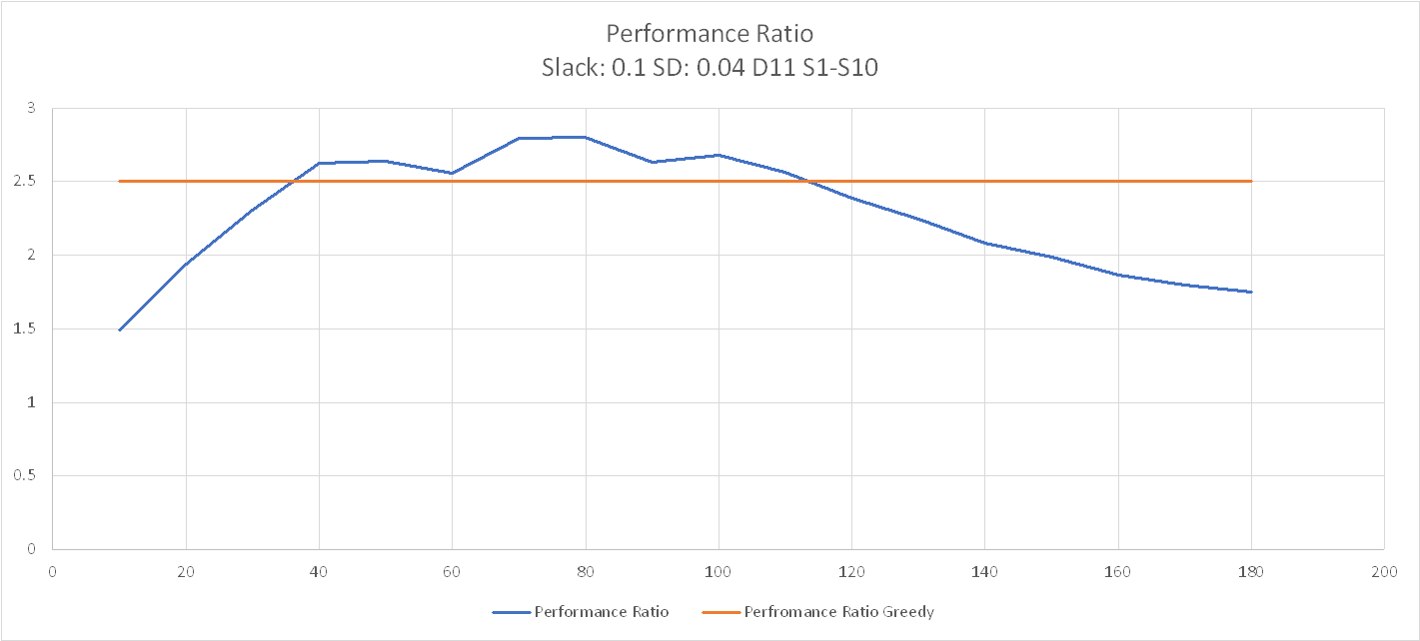

Slide 26
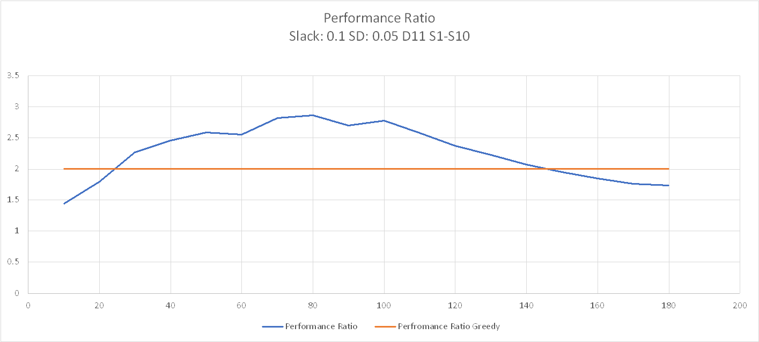

Slide 27
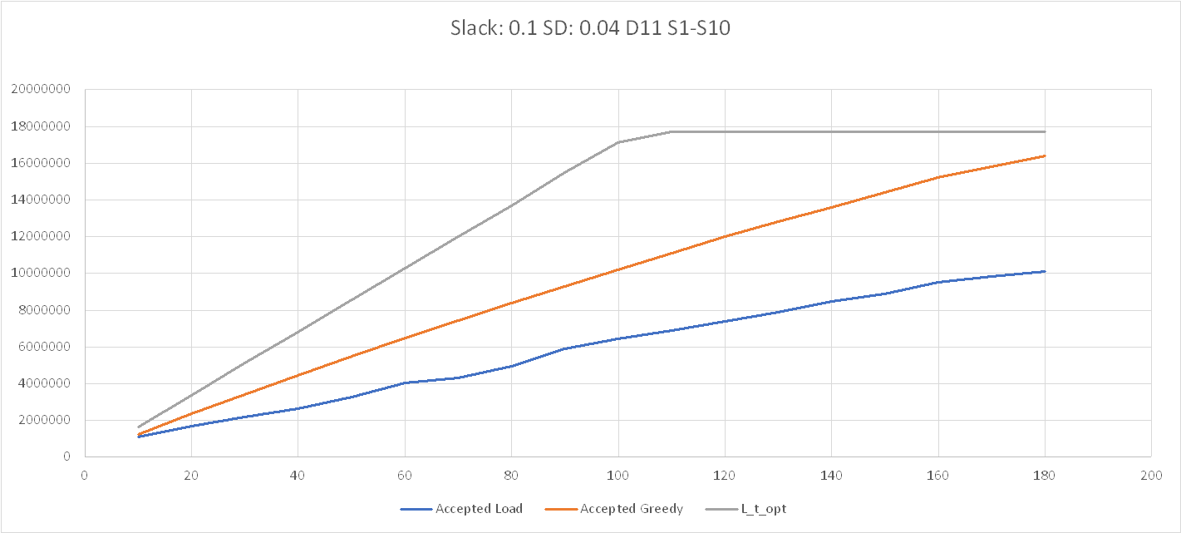

Slide 28
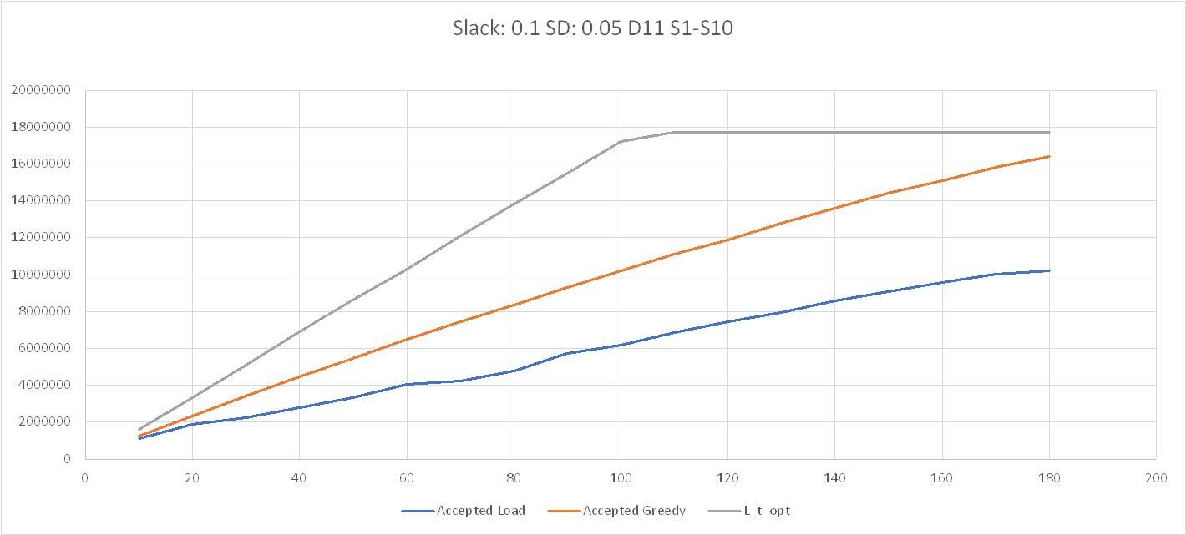

Slide 29
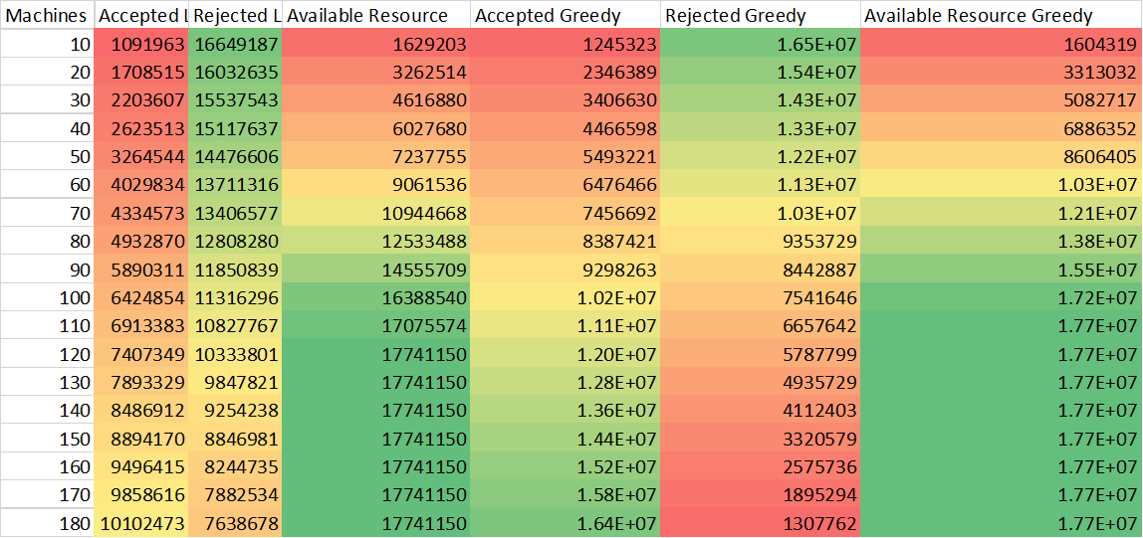
Observations
We can observe that, as the available resources increases, greedy best fit algorithm out performs our machine learning approach by large (Red Colour: lowest, Green Colour: Highest).

Slide 30
However, for less resources the ML approach is comparable to the greedy best fit algorithm.
We can make the observation that the performance ratio of the ML approach for number of machines 30-140 is quite bad. Whereas, the performance ratio of the ML approach is in the satisfactory range for number of machines 10,150,160,170,180.

Slide 31
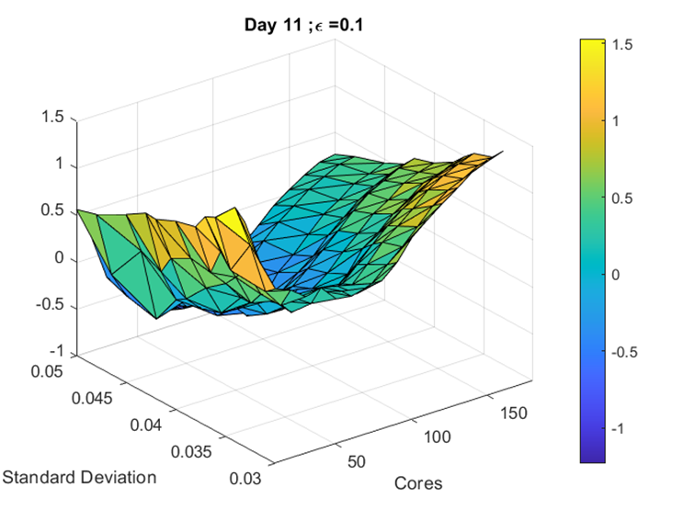
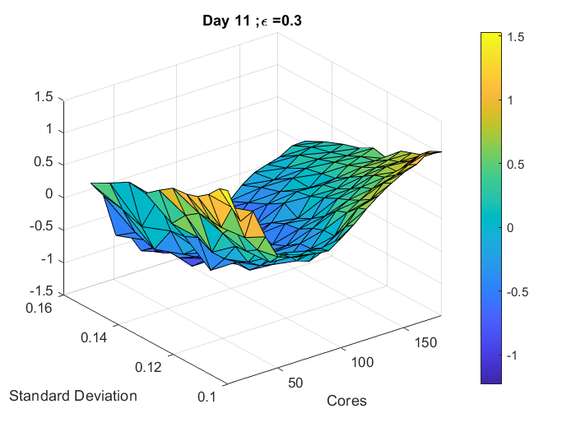
Heat Map Difference In Performance Ratio between ML algorithm and Greedy best fit : Day 11, Slack:0.1, 0.3

Slide 32
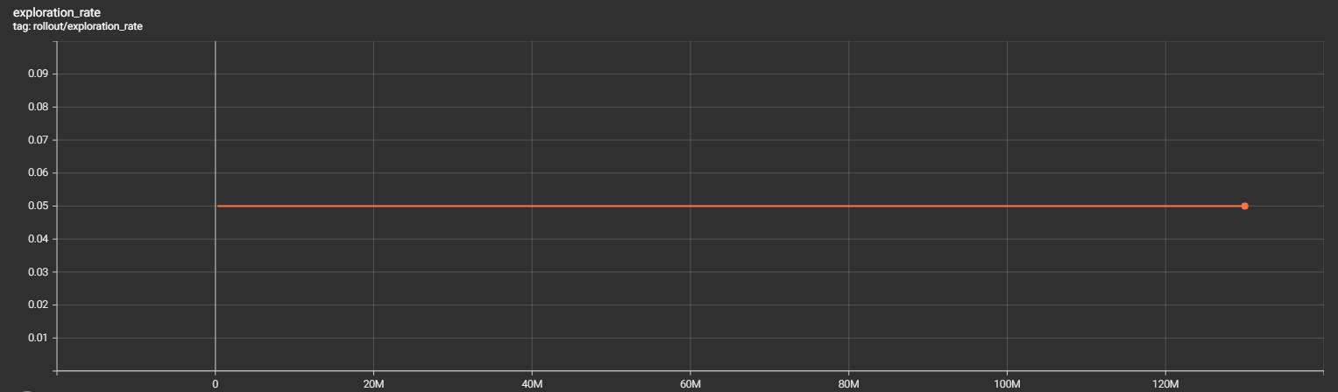
We observe that the exploration rate while training was constant. We have trained for more than 130 million timesteps and we understand that the reward mean converges to an almost constant range.

Slide 33
Conclusion And Future Scope
The results show that our ML approach is not effectively competitive against an offline optimal algorithm in the average case in terms of maximizing machine utilization.
The results of the lower number of machines (resources) gives a slight hope that the algorithm may work better in worst case scenarios. Further testing in tailor made worst case scenarios required.
Whenever a new job is provided, the scheduling decision will be heavily influenced by the current state of the schedule/machine as well as the nature of the new job (which may not follow a historical pattern).

Slide 34
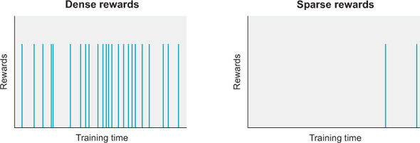
The proposed method employs a dense reward strategy, it attempts to map the current machine state and job locally, make a decision, and issue a reward at each step, without considering the larger picture.
A sparse reward strategy, in which the full timeline is examined as a whole and incentives awarded proportionally at the end, is an alternative for the future.

Slide 35
Contributions
Implementation of common framework
Adaptation of CartPole-v1 environment
Observation space with machine states
Box-plot for Observation Space
Profitability Criterion for reward
Extensive Training and Testing
Generating Results and Report
Philip Varghese Modayil Abdulkader Motorwala
Philip Varghese Modayil

